Slide 1
Ray Tracing : In A Weekend (with a Python)
16 신지홍 정보컴퓨터공학부

Slide 2
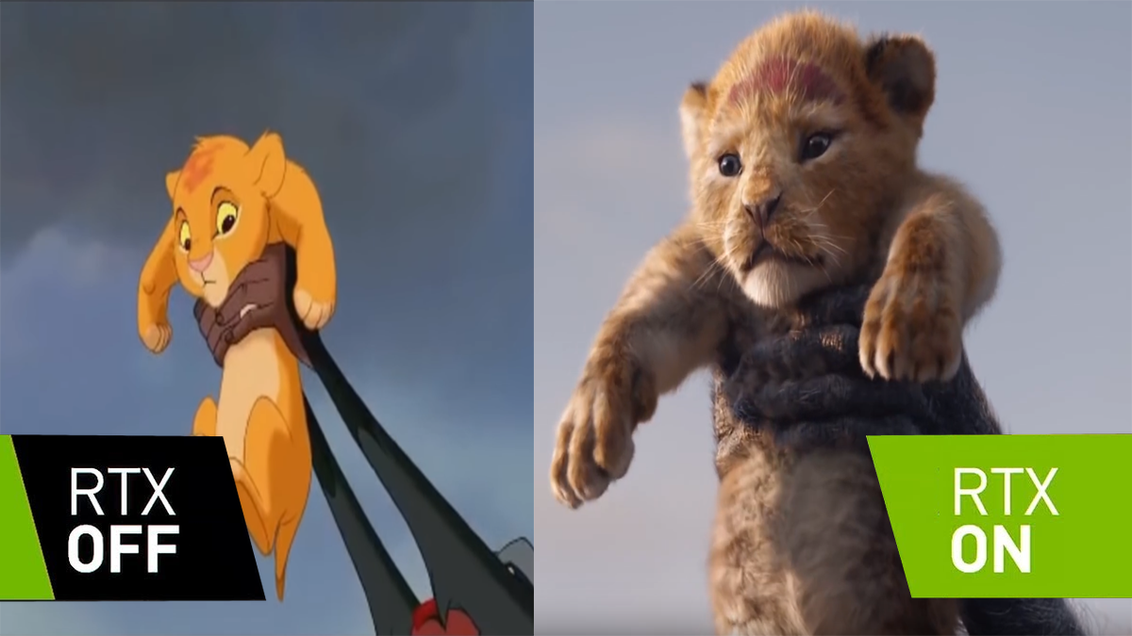

Slide 3
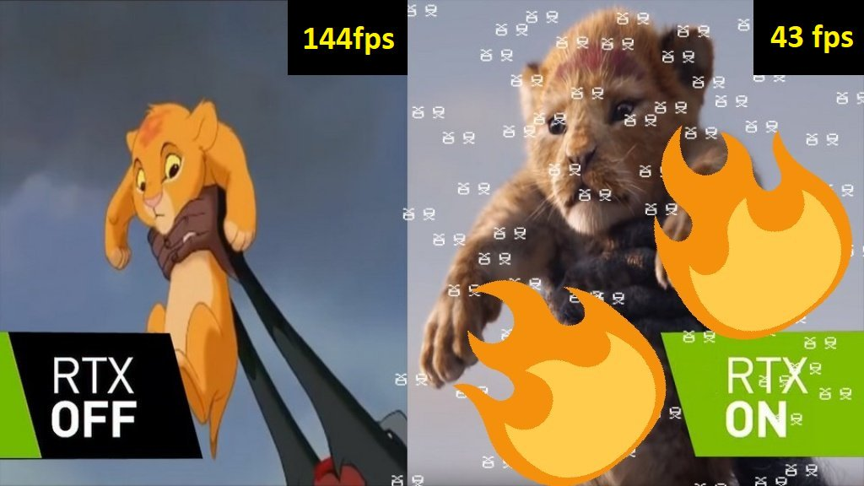
1) https://twitter.com/gamersnexus/status/1065921443790241793

Slide 4
RTX Graphics Card
1) interface for real-time ray tracing for rendering graphics that was created by Nvidia.
1) https://en.wikipedia.org/wiki/RTX

Slide 5

Rasterization vs Ray-Tracing
1) https://www.youtube.com/watch?v=frLwRLS_ZR0&feature=youtu.be

Slide 6

Ray-Tracing
y
카메라
x
z
스크린

Slide 7
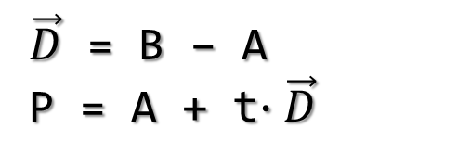

Ray-Tracing
y
t=-1
t=0
t=1
t=1
t=2
A
P
카메라
B
x
$\vec{D}$ = B – A
P = A + t$∙\vec{D}$
A
z
스크린

Slide 8

Ray-Tracing
천장
광원
카메라
y
x
z
스크린
바닥

Slide 9

Hello world!
PPM 파일 포맷
P3
3 2
255
255 0 0
0 255 0
0 0 255
255 255 0
255 255 255
0 0 0
1) https://en.wikipedia.org/wiki/Netpbm_format

Slide 10
Hello world!
width
File open
Write “P3\n20 10\n255\n”
for i = 0; width
for j = 0; height
R = i * 255 / width
G = j * 255 / height
B = 0.2 * 255
Write R G B end of for end of for
File Close
height

Slide 11

Hello world!

Slide 12
Sphere Ray-Tracing
(-2, -1, -1)
(+2, +1, -1)
-z
y
x
z

Slide 13
for i = 0; width
for j = 0; height
(-2, -1, -1)
(
-2 + 4 * i / width,
-1 + 2 * j / height,
-1
)
(+2, +1, -1)
(0, 0, 0)
-z
y
x
z

Slide 14
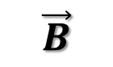
for i = 0; width
for j = 0; height
(-2, -1, -1)
$$\vec{B}$$
(+2, +1, -1)
-z
A
y
x
z

Slide 15
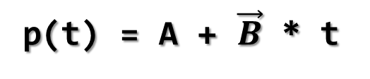
for i = 0; width
for j = 0; height
p(t)
(-2, -1, -1)
$$\vec{B}$$
(+2, +1, -1)
-z
A
y
x
p(t) = A + $\vec{B}$ * t
z

Slide 16
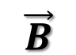
(cx, cy, cz)
(x-cx)^2 + (y-cy)^2 + (z-cz)^2 = R^2
R
p(t)
$$\vec{B}$$
A

Slide 17
(cx, cy, cz)
(x-cx)^2 + (y-cy)^2 + (z-cz)^2 = R^2
dot((p-c), (p-c)) = R*R (p = (x, y, z), c = (cx, cy, cz))
r
p(t)
$$\vec{B}$$
A

Slide 18
(cx, cy, cz)
(x-cx)^2 + (y-cy)^2 + (z-cz)^2 = R^2
dot((p-c), (p-c)) = R*R
(p = (x, y, z), c = (cx, cy, cz))
dot((A+B*t – c), (A+B*t – c)) = R*R
(p = p(t) = A + B*t)
r
p(t)
$$\vec{B}$$
A

Slide 19
(cx, cy, cz)
(x-cx)^2 + (y-cy)^2 + (z-cz)^2 = R^2
dot((p-c), (p-c)) = R*R
(p = (x, y, z), c = (cx, cy, cz))
dot((A+B*t – c), (A+B*t – c)) = R*R
(p = p(t) = A + B*t)
dot(B,B)*t^2 + 2*dot(B,A-C)*t + dot(A-C,A-C) – R*R = 0
r
p(t)
$$\vec{B}$$
A

Slide 20
(x-cx)^2 + (y-cy)^2 + (z-cz)^2 = R^2
dot((p-c), (p-c)) = R*R
(p = (x, y, z), c = (cx, cy, cz))
dot((A+B*t – c), (A+B*t – c)) = R*R
(p = p(t) = A + B*t)
dot(B,B)*t^2 + 2*dot(B,A-C)*t + dot(A-C,A-C) – R*R = 0
a*t^2 + b*t + c = 0 (a=dot(B,B), b=2*dot(B,A-C), c=dot(A-C,A-C)-R*R))
(cx, cy, cz)
r
p(t)
$$\vec{B}$$
A

Slide 21
(x-cx)^2 + (y-cy)^2 + (z-cz)^2 = R^2
dot((p-c), (p-c)) = R*R
(p = (x, y, z), c = (cx, cy, cz))
dot((A+B*t – c), (A+B*t – c)) = R*R
(p = p(t) = A + B*t)
dot(B,B)*t^2 + 2*dot(B,A-C)*t + dot(A-C,A-C) – R*R = 0
a*t^2 + b*t + c = 0 (a=dot(B,B), b=2*dot(B,A-C), c=dot(A-C,A-C)-R*R))
D=b^2-4*a*c
(cx, cy, cz)
r
p(t)
$$\vec{B}$$
A

Slide 22

흠…..

Slide 23

2D 물체와 3D 물체의 차이

Slide 24
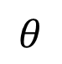
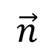
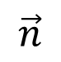
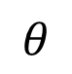
1) Bright
$$\vec{n}$$
$$θ$$
2) Dark
$$\vec{n}$$
$$θ$$

Slide 25
(x-cx)^2 + (y-cy)^2 + (z-cz)^2 = R^2
dot((p-c), (p-c)) = R*R
(p = (x, y, z), c = (cx, cy, cz))
dot((A+B*t – c), (A+B*t – c)) = R*R
(p = p(t) = A + B*t)
dot(B,B)*t^2 + 2*dot(B,A-C)*t + dot(A-C,A-C) – R*R = 0
a*t^2 + b*t + c = 0 (a=dot(B,B), b=2*dot(B,A-C), c=dot(A-C,A-C)-R*R))
D=b^2-4*a*c
(cx, cy, cz)
r
p(t)
$$\vec{B}$$
A

Slide 26

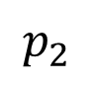
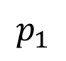
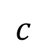
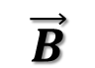
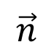
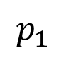
$$p_{2}$$
(cx, cy, cz)
$$c$$
r
$$p_{1}$$
$$p_{1}$$
p(t)
접선
$$\vec{B}$$
$$\vec{n}$$
A

Slide 27
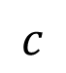
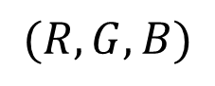
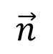
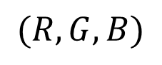
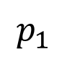
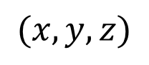
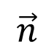
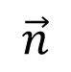
$$\vec{n}$$
vector
normalize
$$c$$
$$\vec{n}$$
Unit vector
$$(x, y, z)$$
-1 ~ 1
$$p_{1}$$
conversion
접선
$$(R,G,B)$$
0 ~ 1
$$(R,G,B)$$
$$\vec{n}$$

Slide 28


Slide 29
200
100

Slide 30

200
100

Slide 31
References )
http://www.realtimerendering.com/raytracing/Ray%20Tracing%20in%20a%20Weekend.pdf
http://www.realtimerendering.com/raytracing/Ray%20Tracing_%20The%20Next%20Week.pdf

